Slide 1
BIOLOGICAL EVOLUTION
OF HUMAN BEING
Chapter Six • From Prehistory to Human Cultural Development
A classroom presentation based on the supplied chapter

Slide 2
01 • OPENING INQUIRY
The central question
How did modern humans emerge
from the prehistoric past?
PREHISTORY
EVIDENCE
INTERPRETATION
Events that are difficult to trace directly with surviving records.
Fossils, material remains and later historical records.
The chapter places scientific and Sufi readings in dialogue.
Biological Evolution of Human Being • Chapter Six | 2

Slide 3
02 • FRAMING THE EVIDENCE
Prehistory → History
PREHISTORIC PERIOD
HISTORIC PERIOD
The chapter describes prehistoric events as difficult to trace with the tools available to us and therefore often treated as speculative.
Written records allow events to be traced with greater accuracy; the transition point varies by region.
QUESTION
QUESTION
QUESTION
What counts as evidence?
What remains uncertain?
How should different interpretations meet?
Biological Evolution of Human Being • Chapter Six | 3
Notes:
All questions can be addressed through scientific observations and evidences in Historic era like Archaology, anthropology , geography.

Slide 4
03 • EVOLUTIONARY NARRATIVE
The biological sequence presented in the chapter
Ramapithecus
Australopithecus
Homohabilis
Homo erectus
Homo sapiens
12–14 mya
man-like primate
~3.9 mya
upright / changing anatomy
2.4–1.2 mya
tools; larger brain
1.8m–300k
fire, tools, migration
500k onward
archaic → Neanderthal → sapiens
Biological Evolution of Human Being • Chapter Six | 4

Slide 5
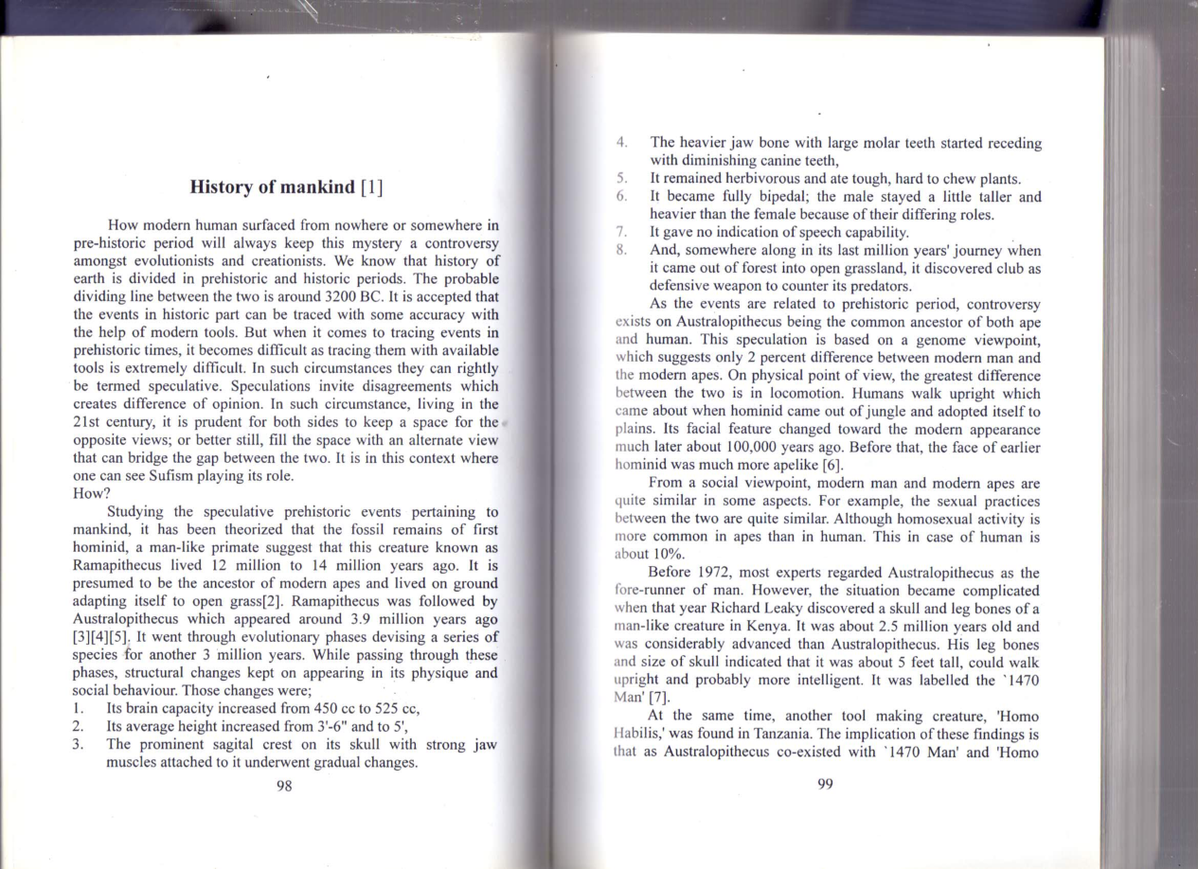
04 • HOMINID DEVELOPMENT
Australopithecus: a debated stage
• Appeared around 3.9 million years ago, according to the chapter.
• Brain capacity: about 450 cc → 525 cc.
• Average height increased from roughly 3′6″ toward 5′.
• Jaw, teeth and skull structure changed gradually.
• Fully bipedal; no clear indication of speech capability is reported in the chapter.
• Later discoveries such as the “1470 Man” complicated the simple ancestor narrative.
Source page image
Biological Evolution of Human Being • Chapter Six | 5

Slide 6
05 • HOMO HABILIS & HOMO ERECTUS
From tool-making to wider movement
HOMO HABILIS
HOMO ERECTUS
“Handy man”
• 2.4–1.2 million years ago
• Tools found with fossil remains
• Brain size presented as ~500 → 800 cc
• About 5 feet tall in the chapter
• Speech capability is suggested, not established
A long-lasting species in the chapter
• 1.8 million–300,000 years ago
• Brain expanded to about 1200 cc
• Tools and hunting weapons
• Fire used for cooking
• Migration beyond Africa
• Clothing associated with colder climates
Biological Evolution of Human Being • Chapter Six | 6

Slide 7
06 • THE MODERN HUMAN STORY
Homo sapiens: three successive stages
ARCHAIC HOMO SAPIENS
NEANDERTHALS
HOMO SAPIENS SAPIENS
~500,000–150,000 years
Presented as a bridge between Homo erectus and later Homo sapiens.
Brain average: ~1200 cc
Definite speech capability is reported.
~150,000–35,000 years
Europe and Middle East.
The chapter notes uncertainty about their relationship with later Homo sapiens and cites then-current DNA interpretations.
First appeared ~120,000 years ago.
Around 40,000 years ago: form described as almost indistinguishable from modern humans.
Average brain size: ~1350 cc.
Biological Evolution of Human Being • Chapter Six | 7

Slide 8
07 • SCIENCE, CREATION & SUFI READING
Two interpretive vocabularies
EVOLUTIONIST VOCABULARY
SUFI VOCABULARY
The chapter describes evolutionists as explaining change through natural processes, including natural selection and “survival of the fittest.”
The chapter presents a “controlled evolution” reading in which God is the sustaining force behind the evolutionary process.
The chapter’s key move: compare the explanatory vocabularies without assuming they are identical.
Biological Evolution of Human Being • Chapter Six | 8

Slide 9
08 • QUR’ANIC INTERPRETATION PRESENTED IN THE CHAPTER
The Sufi reading: a sequence of stages
Dust
Clay
Water
Plants
Animals
Humans
مِن تُرَاب
Matter / earliest stage
طِين
Jamadaat / matter
ماء
Origin of life
نبات
Nabataat
حيوان
Haywanaat
إنسان
Upright, knowing being
The chapter links Qur’anic verses to this sequence as an interpretive model; it presents this as a Sufi understanding, not as a claim that the Qur’an is a science textbook.
Biological Evolution of Human Being • Chapter Six | 9

Slide 10
09 • BRAIN, UPRIGHT POSTURE & KNOWLEDGE
What separates the human stage?
1 • UPRIGHT WALK
2 • BRAIN EXPANSION
The chapter links bipedal locomotion with a major separation from other primates.
Expanded brain capacity is presented as essential to later knowledge and adaptation.
3 • SENSORY COORDINATION
4 • KNOWLEDGE & ADAM
Hearing, sight and speech are discussed as capacities supporting knowledge.
The chapter interprets Adam’s knowledge as central to human distinction and responsibility.
Biological Evolution of Human Being • Chapter Six | 10

Slide 11
10 • QUR’ANIC STAGES DISCUSSED IN THE CHAPTER
From human origin to embryological development
Nutfah
‘Alaqah
Mudghah
Bones
Flesh
Another creation
fertilized egg / zygote
attached stage
“little lump”
skeletal formation
clothing the bones
human
being
Teaching distinction: the chapter presents these verses as spiritually meaningful and connects them to embryological development.
Biological Evolution of Human Being • Chapter Six | 11

Slide 12
11 • THE AGRICULTURAL REVOLUTION
Biological evolution becomes cultural evolution
DOMESTICATION
RIVER SETTLEMENTS
SOCIAL COMPLEXITY
Animals were tamed, domesticated and bred; grains were cultivated.
Growing agriculture required water, encouraging settlements around major river systems.
Larger settlements produced division of labour, specialization and increasingly complex societies.
Key transition: survival → settlement → specialization → social organization
Biological Evolution of Human Being • Chapter Six | 12

Slide 13
12 • FROM STONE AGE TO BRONZE AGE
Technology, trade, writing & metallurgy
STONE
CLAY
WOOD
crude tools • hunting • settlement
pots • storage • figurines • decoration
fishing • canoes • navigation
METAL
BRONZE
WRITING
copper • tin • silver • gold
agriculture • social life • warfare
accounting • trade • record keeping
Biological Evolution of Human Being • Chapter Six | 13

Slide 14
13 • PHILOSOPHY, THEOLOGY & SPIRITUALITY
Entering the historic world
GREEK PHILOSOPHY
ASIAN TRADITIONS
RELIGIOUS TRADITIONS
The chapter highlights Socrates, Plato and Aristotle in the 5th century BC.
Confucianism and Taoism in China; Buddhism and Jainism in India.
Zoroastrianism and Jewish monotheism are included in the chapter’s overview.
The chapter concludes by opening three themes: Mankind & Theology • Mankind & Philosophy • Mankind & Spirituality
Biological Evolution of Human Being • Chapter Six | 14

